Slide 1
KDP Tour Mockup
Created by: Therese Kay

Slide 2
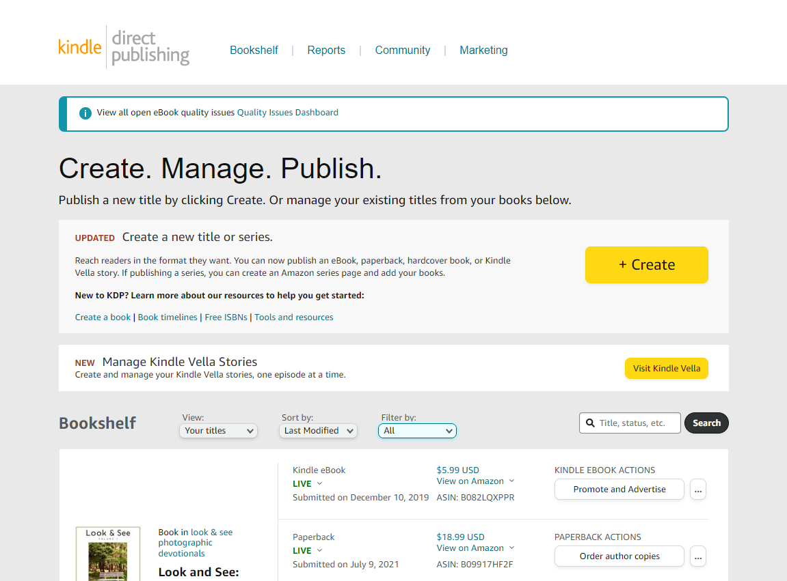

Slide 3
Bookshelf
View all the titles you have published
Back Next End

Slide 4
Reports
View Sales Reports for your titles
Back Next End

Slide 5
Community
Engage with the KDP community discussion boards
Back Next End

Slide 6
Marketing
Create or track Amazon ads for your titles
Back Next End

